Slide 1





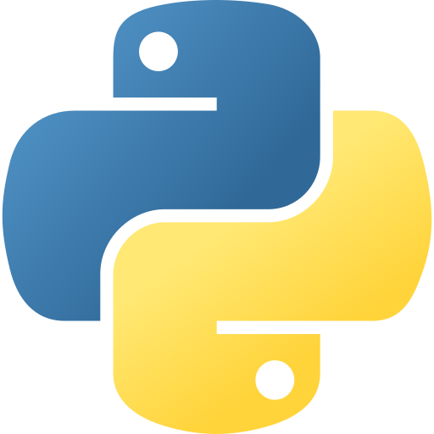





Introduction to
Python
Python Programming Language
Radwan Albahrani
7:00 PM – 9:00 PM
Zoom Meeting

Slide 2






What will we learn?
Getting started with Python
Python Introduction
Python Flow Control
Python Functions
Python Datatypes

Slide 3
Getting Started with Python
Python is a cross-platform machine-independent programming language, which means that it can run on multiple platforms: Windows, macOS, and Linux. Python is free and open-source language
Your first Python Program:
print("Hello, world!")

Slide 4
Python Introduction
Python Variables:
Container to hold data.
college_name = 'CCSIT'
print(college_name )
Python is a Type-inferred Language
Python Data Types:
Numeric | String | Sequence | Mapping | Boolean | Set
Int, float, complex | str | List, tuple, range | dict | bool | Set, frozeenset

Slide 5

Python Operators
Arithmetic Operators: + , - , * , / , % , **
Assignment Operators: =, += , -= , *= , /= ,%= , **=
Comparison Operators: == , != , > , < , >= , <=
Logical Operators: and , or , not
Bitwise Operators: & , | , ~ , ^ , >> , <<
Special Operators: is , is not , in , not in
is: return true if the operands are identical.
is not: return true if the operands are not identical.
in: return true if an item belongs to sequence.
not in: return false if an item not belongs to sequence.
a = 2
b = 4
print ('Sum: ', a ** b)
a = 10
b = 5
a += b # a = a + b
print(a)
a = 2
b = 3
print('a != b =', a != b)
print(True and False)
a = 2
b = 3
print(a is not b)
a = “hello”
print( ‘h’ not in a)

Slide 6

Python Datatypes
Python List
Lists are used to store multiple elements and work with them at the same time
Negative indexes allowed in python. It refers to the last elements. -1 for the last element, -2 for the second last element, and so on. For example:
The list slicing by taking a partition from list:
There is a list of function we can use to make a change on lists:
append(): add to the end of the list.
extend(): add all elements to another list.
insert(): insert at the specified index.
remove(): remove an item from list.
clear(): remove all list items.
Syntax:
my_list1 = [1,2,3]
We can save mixed datatypes inside the list.
The list can be nested lists.
Access the element inside the list through the index.
Print(my_list1[-1]# output is 3
my_list2 = [1,”CCSIT”,3.5]
My_list[start index : end index -1]
my_list3 = [1,[2,3],4]
Print(my_list3[1][0]) # output is 2

Slide 7
Python Datatypes
Python Tuple
Similar to list. However, we can not change the elements once assigned.
Syntax:
my_tuple = (1,2,3)
Access a specific element through indexing, whether positive or negative, the same as lists.
The list slicing by taking a partition from list:
In order to delete a tuple:
count() and index() functions will return the index of the item within the tuple.
We can save mixed datatypes inside the tuple.
The tuple can be nested tuple.
Tuple packing(): creating tuple without ()
Tuple unpacking:
Print(my_tuple2[0])# output is 1
my_tuple2 = (1,”CCSIT”,3.5)
My_tuple2[start index : end index -1]
my_tuple3 = (1,[2,3],4,(5,6,7),8)
del my_tuple2
my_tuple2 = 1,”CCSIT”,3.5
a , b , c = my_tuple2
print(a) # 1

Slide 8
Python Datatypes
Python Sets
A collection of unordered items, no duplicate items, and sets must be immutable.
Syntax:
my_set = { 1 , 2 , 3 }
We can remove an item using the discard() method, if the item is not present, will leave the list as it is.
We can remove also using the remove() function, however, it will generate an error if the item not present.
We can perform the other operations on sets: insertion – difference - union - symmetric
We can save mixed datatypes inside the set.
Update the set using add and update method:
my_set1 = { 1 , “CCSIT” , 3 }
my_set = {1, 3}
my_set.add(2)
print(my_set)
my_set.update([2, 3, 4])
print(my_set)
my_set.update([4, 5], {1, 6, 8})
print(my_set)
my_set = {1, 3, 4, 5, 6}
my_set.discard(4)
print(my_set)
my_set.remove(6)
print(my_set)

Slide 9
Python Datatypes
Python Directories
A collection of ordered items, each item with key/value pair.
Syntax:
my_dict = { 1 : ”CCSIT”, 2 : “GDSC”, 3 : “AI and Robot Club” }
access elements in directories using indexing, however, there is an error incase not found:
Or using get() method, but here there is no error if the element not found.
There is a list of functions we can use to make a change on directories:
clear(): remove all directory items.
popitem(): remove an item arbitrary
Update(): it is used to update an existing item, and overwrite the previous values.
print(my_dict[2]) # GDSC
print(my_dict.get(2)) # GDSC

Slide 10

Type Conversions
The process of converting data of a particular type to another
01
02
Implicit Conversion
Explicit Conversion
integer_number = 123
float_number = 1.23
new_number = integer_number + float_number
print("Value:",new_number)
print("Data Type:",type(new_number))
num_string = '12'
# explicit type conversion
num_string = int(num_string)
print("Data type of num_string after Type Casting:",type(num_string))
02
4
type(): it is a built-in function that returns the type of data.
int(): it receives input and converts it to int datatype.
Functions will be covered later inshallah!

Slide 11
Python I/O
Python Output
Python Input
print() : function used to print in python.
However, it receives 5 parameters:
input(): function used to take input from the user. It takes a string to prompt the user for input.
print(object= separator= end= file= flush= )
num = input('Enter a number: ')
print('You Entered:', num)
Example:
print('New Year', 2023, 'See you soon!', sep= '. ')

Slide 12
Take a break!
Bring your coffee and come back to AI world!
#AI_YES_PLEASE

Slide 13

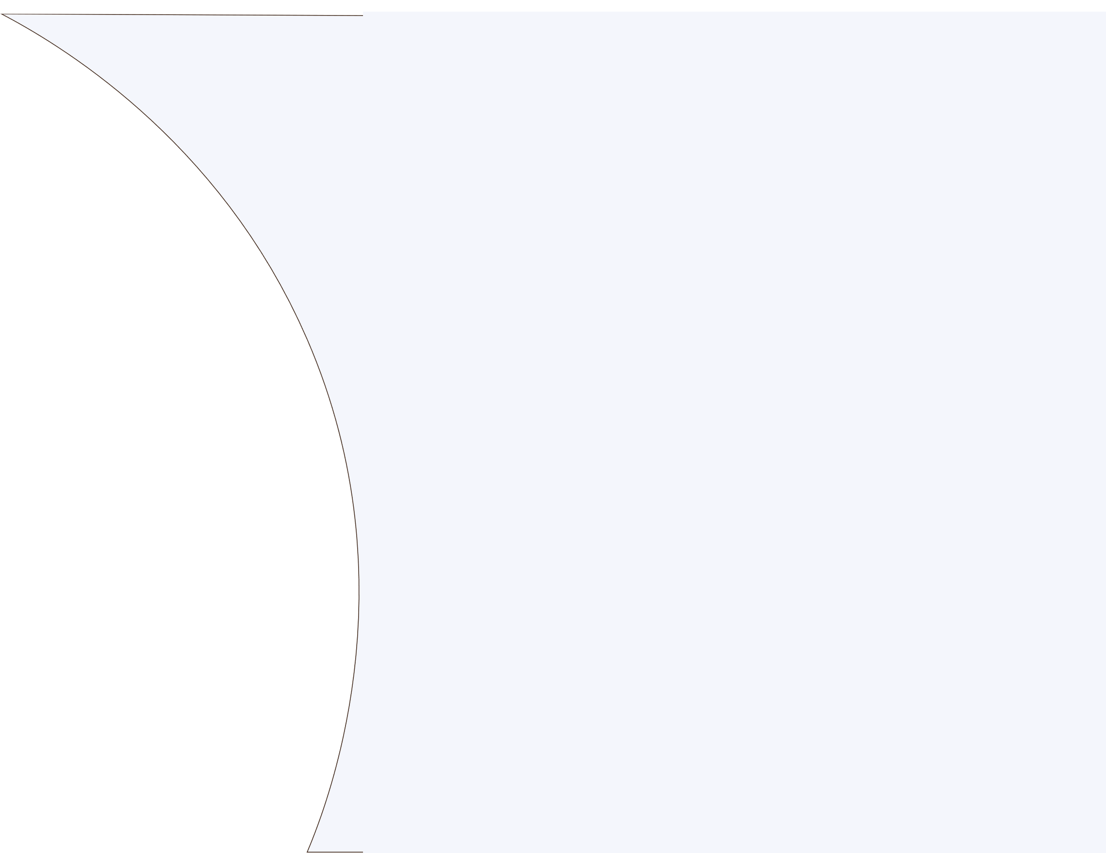



Python Flow Control
If statements
Decisions are required to be taken based on a condition in order to execute a piece of code.
If statement
If-else statement
If-elif-else statement
Nested if statement
Syntax:
Syntax:
Syntax:
Syntax:
if condition :
statement(s) to execute
if condition :
body of if
else :
body of else
if condition :
body of if
elif condition :
body of elif
else :
body of else
if condition :
if condition :
body of inner if
Example:
Example:
Example:
num = float(input("Enter a number: "))
if num >= 0:
if num == 0:
print("Zero")
else:
print("Positive number")
else:
print("Negative number")
num = 3
if num > 0:
print(num, "is a positive number.")
num = 3
if num > 0:
print(num, "is a positive number.")
else :
print(num, "is a negative number.")
Example:
if num > 0:
print("Positive number")
elif num == 0:
print("Zero")
else:
print("Negative number")

Slide 14

Python Flow Control
For Loop
While Loop
For loop is used to iterate through a sequence of elements in a list, tuples, directories, and strings.
While loop is used to iterate through a block of statements as long as the condition is true.
Syntax
Example:
Syntax
Example:
# List of numbers
numbers = [6, 5, 3, 8, 4, 2, 5, 4, 11]
sum = 0
for val in numbers:
sum = sum+val
print("The sum is", sum)
n = 10
sum = 0
i = 1
while i <= n:
sum = sum + i
i = i+1 # update counter
print("The sum is", sum)
for item in sequence:
body of for loop
while condition:
body of for while
range(): it is a function that can be used with for loop to specify the range of iteration. We can define the start, end, and step size.
Note: we can use an optional else statement to be executed when the condition in the while loop becomes false. Similarly, for loop iteration once finish, we can use an optional else clause.
Example:
for i in range(start,end,step):
body of for loop
for i in range(2,20,3)):
print(i)

Slide 15
Python break-continue
Python break statement
Python continue statement
The break statement will terminate the loop once executed.
The continue statement it will skip the remaining code in a current iteration and start a new iteration.
Example:
Example:
for val in "string":
if val == "i":
break
print(val)
print("The end")
for val in "string":
if val == "i":
continue
print(val)
print("The end")

Slide 16

Python Functions
A function is a set of related statements that will be executed when it is called.
The function accepts arguments
Or it could be a non-argument function.
The function can return a value
Or non-returned type.
The function can be a user-defined or built-in function.
How to call the function? Simply by the name of the function
Syntax:
def function_name(parameters) :
statement(s)
def greet(name):
print("Hello, " + name + ". Good morning!")
greet(“AI and Robot Club”) # call
Example of non-returned type function:
Example of returned type function:
def greet(name):
print("Hello, " + name + ". Good morning!")
def absolute_value(num):
if num >= 0:
return num
else:
return -num
print(absolute_value(2))
Return statement: used to exit from a function and assign the returned value to a variable(maybe list, tuple), or simply print it.
This function named “greet” it will print the user a greeting message.

Slide 17
Python Functions
Built-in functions: is a function written in Python Module we can call it implicitly or explicitly by importing its module. For example:
Built-in function
Import math module to use sin() function. (this will be covered in Python Modules!)
Implicit call such as: print() and input()
The function accepts arguments, or it could be a non-argument function.
The function can have default arguments:
The function can have Keyword arguments:
With an arbitrary number of arguments:
def add_numbers( a = 7, b = 8):
sum = a + b
print('Sum:', sum)
add_numbers(2, 3)
add_numbers(a = 2)
def find_sum(*numbers):
result = 0
for num in numbers:
result = result + num
print("Sum = ", result)
find_sum(1, 2, 3)
find_sum(4, 9)
def display_info(first_name, last_name):
print('First Name:', first_name)
print('Last Name:', last_name)
display_info(last_name = 'Cartman', first_name = 'Eric')

Slide 18
Python Modules
A module is a file containing code to perform a specific task. It may contain variables, constants, classes, and functions. Also, we can create or own modules in python.
How to create a module?
1. First, let’s name a file called “addition.py”, then build a function to find the sum of two integers.
Python contains over 200 built-in modules, and we can import them the same way we did previously.
Let call pi value from math module:
Addition.py
def add(a, b):
result = a + b
return result
import math
# use math.pi to get value of pi
print("The value of pi is", math.pi)
How to use the module?
2. Import the module that you have created in main.py
By writing the “import” keyword with the name of the module.
Import addition
3.Call the method “add” by writing: addition.add(x,y) , which x and y can be any two numbers.
print(addition.add(2,3)) # return 5

Slide 19
Python Modules
We can rename the module
Python from...import statement
For example, let take the math module, we can rename it to m:
We can use from…import statement when we want to import specific functions, variables, or particular things inside the module.
import math as m
print(m.pi)
# import only pi from math module
from math import pi
print(pi)
Import all names
We can import all names(the definitions) inside the module except the private definitions that start with an underscore.
We used * in order to call all available definitions except the private ones. See how we can simply write “pi” without the name of the module.
from math import *
print("The value of pi is", pi)

Slide 20
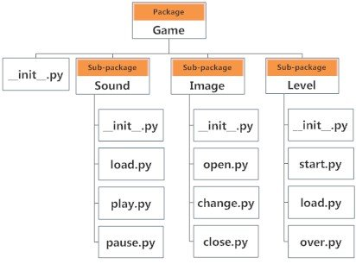
Python Packages
As our application program becomes larger, and the number of modules may increase, we can organize our modules to be saved in a package. Different modules are saved in different packages.
How can we import a module within a package?
2 ways to import module play:.
from Game.Sound import Play
import Game.Sound.Play
calling a function within the play module named move():
import Game.Sound.Play
Game.Sound.Play.move(3)
from Game.Sound import Play
Play.move(3)
from Game.Sound.Play import move
move(3)

Slide 21
Take a break!
Bring your coffee and come back to AI world!
#AI_YES_PLEASE

Slide 22


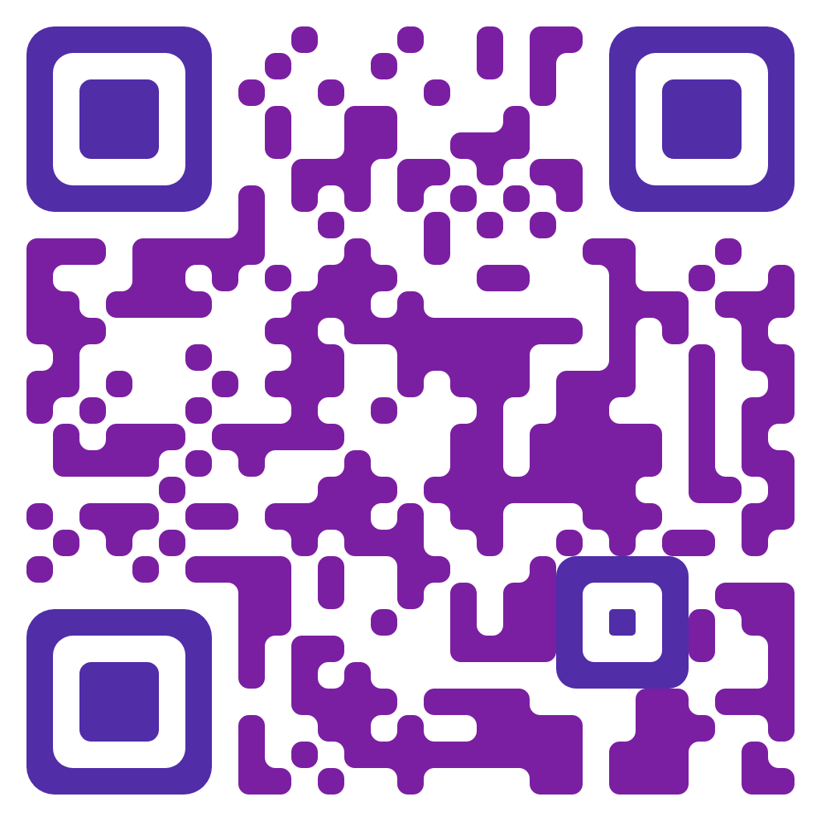

Test yourself!

Slide 23

Reference
Introduction to
Python
Team
Zeina Alabido
Reem Alshami
Raghad Aljiban
Aseel Alqahtani
Haya Almossaeed
Radwan Albahrani

Slide 24


Thank You

